Slide 1

The Pythonizers
COVID-19 Visualization and Prediction

Slide 2
Feasibility and Module
In this project we are going to analysis the covid data to predict where the future cases will be increased or decreased by implementing the different analytics technique and use the result in the future.
The data contain the number of cases across the globe, and we will predict the cases to be in the next week in the globe.
The idea to develop this project is to predict the future scenario of any pandemic.
In this data we can predict the number of cases for the single country or for the entire Globe.
COVID-19 cases in Globe
Use of EDA
Use of different Algorithm for the prediction
Predicting number of cases in the near future

Slide 3
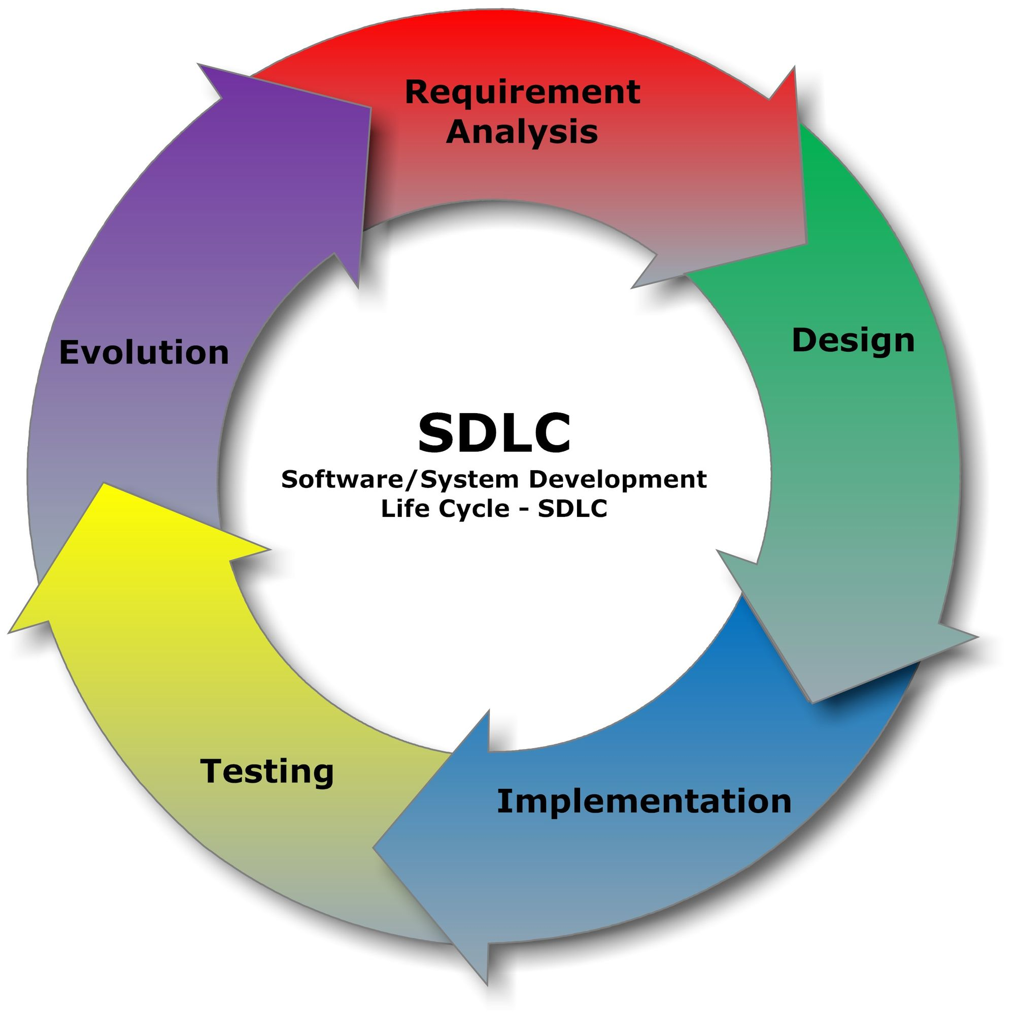
SDLC
Software development life Cycle give us the brief idea about how the workflow goes and in which phase we need improve to derived our desired result

Slide 4
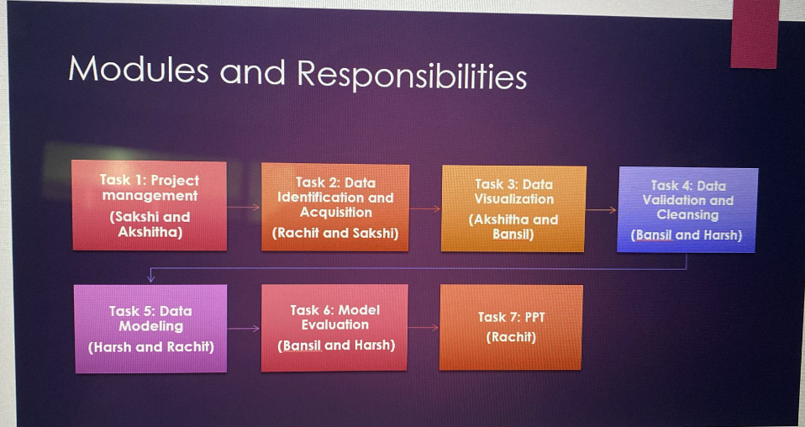
Team Responsibility and Module
Here are the Responsibility and the module to be used in our project

Slide 5

Outcome
Based on trends, predicting the probability of number of cases in the near future.
Using various algorithms and approaches to predict the future.

Slide 6

References
https://www.kaggle.com/competitions/covid19-global-forecasting-week-3

